Slide 1
Global Disability Leadership Before, During and After Disasters… What’s Happening and How You Can Get Involved
Marcie Roth
Executive Director and CEO
World Institute on Disability
www.wid.org

Slide 2
The Frequency, Intensity and Duration of Disasters is Growing
A disaster related to a weather, climate or water hazard occurred every day on average over the past 50 years – killing 115 people and causing US $202 million in losses daily.
The number of disasters has increased by a factor of five over the 50-year period, driven by climate change, more extreme weather and improved reporting.
Thanks to improved early warnings and disaster management, the number of deaths decreased almost three-fold.
-World Meteorological Organization

Slide 3
Disproportionate Impact
According to the United Nations, “children and adults with disabilities and older adults are 2-4 times more likely to be injured or die in a disaster due to a lack of planning, accessibility and accommodation, most are not due to diagnostic labels or medical conditions.”
-United Nations Sendai Framework for Disaster Risk Reduction - 2015-2030

Slide 4
Millenium Development Goals
In September 2000 world leaders came together to adopt the United Nations Millennium Declaration, committing their nations to a new global partnership to reduce extreme poverty and setting out a series of time-bound targets - with a deadline of 2015 these became known as the Millennium Development Goals.

Slide 5
Millenium Development Goals
Persons with disabilities were not included in the Millennium Development Goals and consequently excluded from many development initiatives and funding streams.

Slide 6
UN Convention on the Rights of Persons with Disabilities (UN CRPD)
There are seven landmark United Nations human rights treaties that protect the rights of women, children, migrant workers and others.
The Convention on the Rights of Persons with Disabilities (CRPD) introduced a new paradigm for persons with disabilities. It shifted policy and policy implementation from a charitable and medical approach to one based on rights.
The CRPD was entered into force on 3 May 2008, as the only global treaty addressing the rights and needs of persons with disabilities, the world’s largest minority.

Slide 7
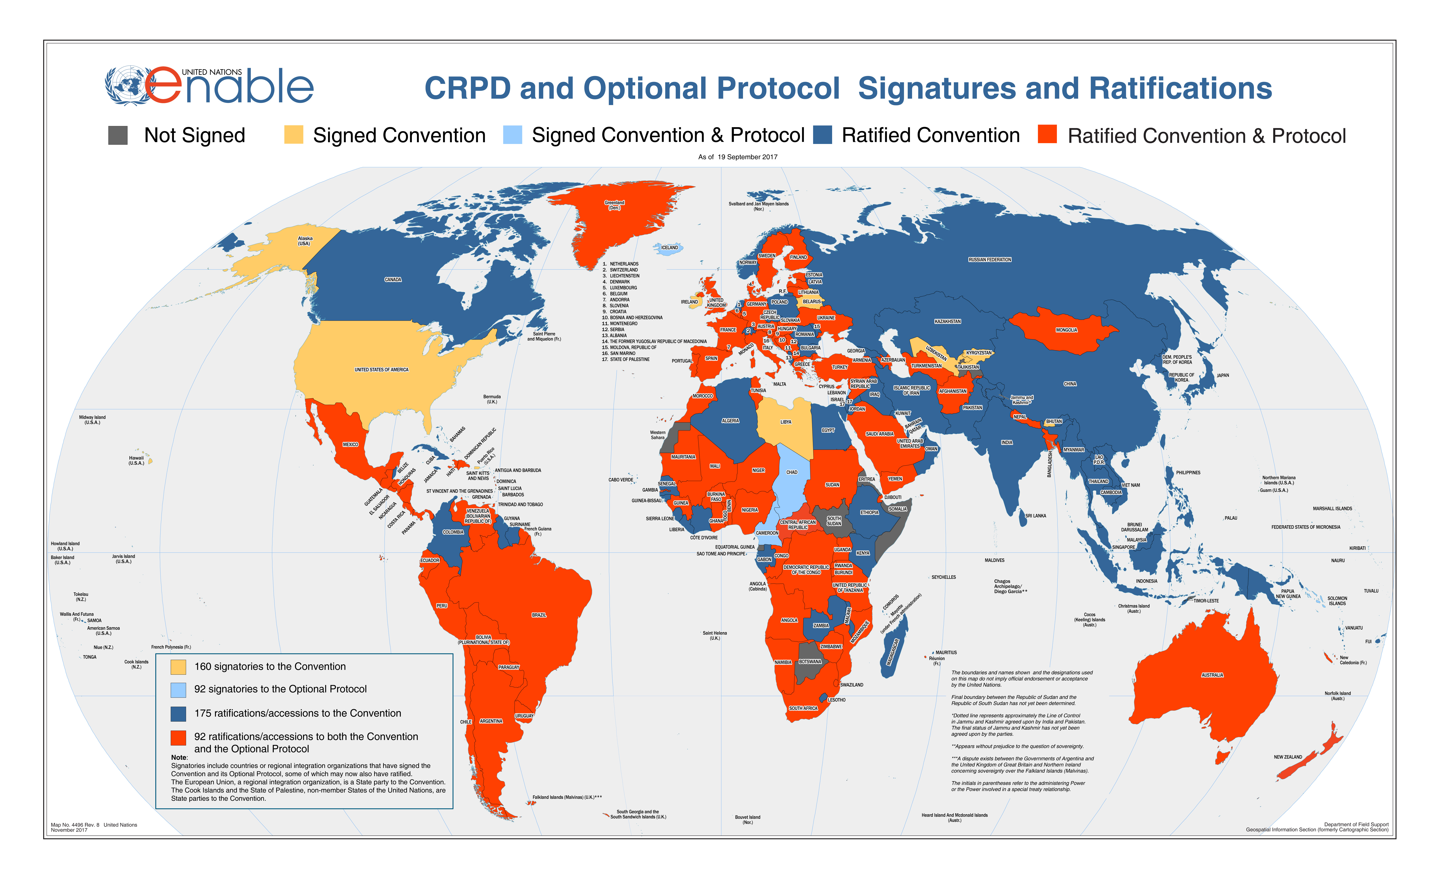
UN Convention on the Rights of Persons with Disabilities (UN CRPD)

Slide 8
UN Convention on the Rights of Persons with Disabilities (UN CRPD)
164 “Member States” (Countries) have signed and ratified the UNCRPD. 9 Member States have not ratified the treaty:
Bhutan
Cameroon
Lebanon
Liechtenstein
Solomon Islands
Tajikistan
Tonga
United States of America
Uzbekistan

Slide 9
UN Convention on the Rights of Persons with Disabilities (UN CRPD).
There are 50 Articles in the CRPD
Article 11
Situations of risk and humanitarian emergencies
States Parties shall take, in accordance with their obligations under international law, including international humanitarian law and international human rights law, all necessary measures to ensure the protection and safety of persons with disabilities in situations of risk, including situations of armed conflict, humanitarian emergencies and the occurrence of natural disasters.

Slide 10
Sustainable Development Goals
The Sustainable Development Goals or Global Goals are a collection of 17 interlinked global goals designed to be a "blueprint to achieve a better and more sustainable future for all".
The SDGs were set up in 2015 by the United Nations General Assembly and are intended to be achieved by the year 2030.

Slide 11
2030 Agenda for Sustainable Development
On 25 September 2015, world leaders adopted the 2030 Agenda
“It was the first time in human history that we as human beings reached consensus on the future of development.”
– UN DESA’s Under-Secretary-General Wu Hongbo
“We could be the first generation to succeed in ending poverty everywhere”.

Slide 12
Universal Ambition vs. National Ownership
The Declaration defines the concept of national ownership as a counterweight to its universality, which is reflected and reinforced throughout the entire Agenda:
“This is an Agenda of unprecedented scope and significance. It is accepted by all countries and is applicable to all, taking into account different national realities, capacities and levels of development and respecting national policies and priorities” (para 5)

Slide 13
“Vulnerable”
Including persons with disabilities among vulnerable people means that whenever ‘vulnerable’ is referenced throughout the Agenda (18 times), these provisions directly apply to persons with disabilities.
The disability movement does not promote the term “vulnerable,” but this term was broadly accepted by governments at the UN. Due to the political sensitivity of the 2030 Agenda negotiations, it was determined by some that it was not possible to change this term.

Slide 14
Comparing the Millennium Development Goals and the 2030 Agenda
Millennium Development Goals (MDGs) | 2030 Agenda
Adopted in 2000 and end in 2015 | Adopted in 2015 and end in 2030
Focus on developing countries | Universal, applies to all countries
To reduce extreme poverty | To eradicate poverty in all its forms and and to realize economic empowerment through sustainable development
8 goals and 18 targets with 48 indicators | 17 goals and 169 targets with 231 global indicators
No references to persons with disabilities | 7 references in SDGs: education (2), employment, reducing inequalities, inclusive cities (2), disaggregation of data by disability (All together 11 in Agenda 2030 and 9 in global indicators)
- International Disability Alliance

Slide 15
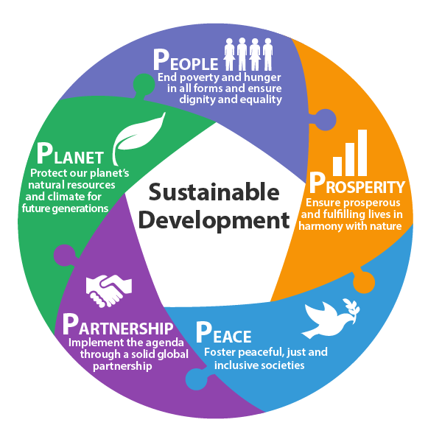
The 5 Ps of Sustainable Development
- UN: sustainabledevelopment.un.org

Slide 16
Sustainable Development
“Sustainable development recognizes that eradicating poverty in all its forms and dimensions, combating inequality within and among countries, preserving the planet, creating sustained, inclusive and sustainable economic growth and fostering social inclusion are linked to each other and are interdependent.”
- 2030 Agenda, Art. 13

Slide 17
Disability Connections to Goals & Targets
Entire 2030 Agenda includes principle of ‘Leave No One Behind’
7 explicit references to persons with disabilities
18 references to ‘vulnerable populations’
All inclusive language links to persons with disabilities
-International Disability Alliance

Slide 18
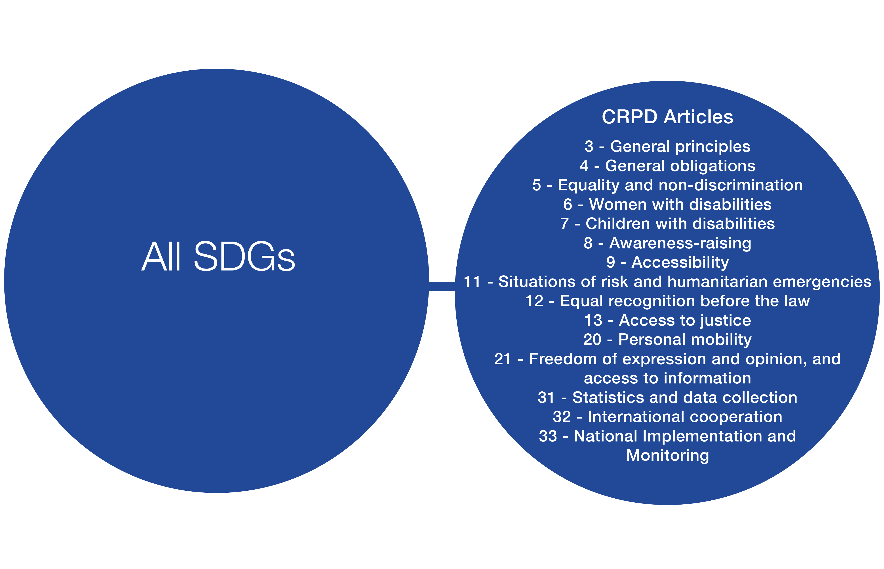
The SDGs and the UN CRPD
Several UN CRPD Articles are cross-cutting in nature and must always be applied and/or considered for the implementation of every Goal and target.
-International Disability Alliance

Slide 19
Accountability
“Persons with disabilities were instrumental in creating this transformational roadmap to a better future. Now the hard work of real change lies directly ahead. Persons with disabilities must be leaders, guiding the world towards achieving these goals for everyone. This journey demands our persistent and unwavering duty to hold our governments accountable to their own commitments. Our full engagement in the follow-up and review mechanism is fundamental. We cannot afford to be left behind again.”
- Maryanne Diamond, Chair of the International Disability Alliance, 2015

Slide 20
Sendai Framework for Disaster Risk Reduction 2015-2030
The Sendai Framework for Disaster Risk Reduction is a 15-year agreement with seven targets and four priorities for action which aim to achieve the substantial reduction of disaster risk and losses in lives, livelihoods and health and in the economic, physical, social, cultural and environmental assets of persons, businesses, communities and countries.
The Sendai Framework is the first major agreement of the 2030 Agenda for Sustainable Development

Slide 21
Sendai Framework for Disaster Risk Reduction 2015-2030
The Framework and priorities were developed with significant involvement of persons with disabilities and is monitored through one global and seven regional biennial events known as the Global and Regional Platforms for Disaster Risk Reduction.
The aim of the Platforms are to review progress, share knowledge and discuss the latest developments and trends in reducing disaster risk. The outcomes of the Global Platform inform the deliberations of the High-Level Political Forum on Sustainable Development.

Slide 22
Sendai Framework Priorities
The four priorities are:
Understanding disaster risk;
strengthening disaster risk governance to manage disaster risk;
investing in disaster risk reduction for resilience; and
enhancing disaster preparedness for effective response and to “build back better” in recovery, rehabilitation, and reconstruction.

Slide 23
Sendai Framework for DRR

Slide 24
Sendai Framework
Sendai Framework for Disaster Risk Reduction 2015-2030 has 5 references to persons with disabilities and an additional two references on universal design
The Sendai Framework for Disaster Risk Reduction recognizes that “not only are persons with disabilities disproportionately affected by disasters, but – crucially – that their knowledge and leadership skills are essential for building resilient, inclusive and equitable societies”.
-United Nations Sendai Framework for Disaster Risk Reduction - 2015-2030

Slide 25
Thematic Group on Disaster Risk Reduction
The Stakeholder Group of Persons with Disabilities: Thematic Group on Disaster Risk Reduction (TG-DRR) is an open coordination mechanism established in 2018 to support the engagement of persons with disabilities, their representative organizations and other relevant stakeholders to contribute to the monitoring of the Sendai Framework for Disaster Risk Reduction (within the 2030 Agenda framework), under the umbrella of the Major Groups and Other Stakeholders mechanism.
If you would like to join the Thematic Group on DRR, you may submit your membership request via this form.

Slide 26
Upcoming Events
Regional Platform for Disaster Risk Reduction in the Americas and the Caribbean
Building Resilient Economies
01 - 04 November 21
Virtual Event

Slide 27
Upcoming Events
Global Platform for Disaster Risk Reduction
From Risk to Resilience: Towards Sustainable Development for All in a COVID-19 Transformed World
The Global Platform for Disaster Risk Reduction is the main global forum to assess and discuss progress on the implementation of the Sendai Framework for Disaster Risk Reduction.
The seventh session of the Global Platform (GP2022) will be organized by the UN Office for Disaster Risk Reduction (UNDRR) from 23 to 28 May 2022, in Bali, Indonesia

Slide 28
Dhaka Declaration
The Dhaka Conference on Disability and Disaster followed the Global Platform for Disaster Risk Reduction in 2015.
Participants adopted the Dhaka Declaration which supports the implementation of the Sendai Framework by calling for inclusion and meaningful participation of persons with disabilities in all disaster risk management programs.
The Declaration was updated in 2018, at the Dhaka Conference on Disability and Disaster Risk Management with targets for 2021.

Slide 29
CHARTER ON INCLUSION OF PERSONS WITH DISABILITIES IN HUMANITARIAN ACTION
The Charter on Inclusion of Persons with Disabilities in Humanitarian Action was launched at the 2016 World Humanitarian Summit by a multi-stakeholder coalition of Member States, United Nations agencies, organisations of persons with disabilities (DPOs), international organisations and civil society organisations.
The Charter demonstrates the collective willingness to enhance the effective inclusion and participation of persons with disabilities and their representative organizations across the humanitarian system.

Slide 30
CHARTER ON INCLUSION OF PERSONS WITH DISABILITIES IN HUMANITARIAN ACTION
The Humanitarian Disability Charter
5 key elements:
Non Discrimination
Participation
Inclusive Policy
Inclusive Response and Services
Cooperation and Coordination

Slide 31
INCLUSION OF PERSONS WITH DISABILITIES IN HUMANITARIAN ACTION
In 2019, the launch of the IASC Guidelines on Inclusion of Persons with Disabilities in Humanitarian Action marked an important point in efforts to ensure that persons with disabilities are fully included as both beneficiaries and actors in humanitarian response.

Slide 32
INCLUSION OF PERSONS WITH DISABILITIES IN HUMANITARIAN ACTION Reference Group
The Reference Group is a platform fostering cooperation between UN, International Agencies, NGOs and organizations of persons with disabilities in promoting disability inclusive humanitarian response, including, but not limited to, supporting the development, dissemination and implementation of key guidance materials, including the IASC Guidelines.

Slide 33
Reference Group
Membership is open to international, regional and local organizations of persons with disabilities (OPDs), non-governmental organizations (NGOs) and UN agencies, as well as interagency networks, multilateral or bilateral agencies, private sector, academics and others committed to promoting inclusion of persons with disabilities in humanitarian action.
Reference Group Membership

Slide 34
FIVE ACTIONS FOR DISABILITY-INCLUSIVE DISASTER RISK MANAGEMENT
Include Persons With Disabilities As Valued Stakeholders In Disaster Risk Management Activities.
Help Remove Barriers To The Full Participation Of Persons With Disabilities.
Increase Awareness Among Governments And Their Partners Of The Safety And Security Needs Of Persons With Disabilities.
Collect Data That Is Disaggregated By Disability.
Ensure That New Construction, Rehabilitation, And Reconstruction Are Accessible To Persons With Disabilities.
https://www.gfdrr.org/sites/default/files/GFDRR%20Disability%20inclusion%20in%20DRM%20Brief_FO.pdf

Slide 35
Disability Inclusive Climate Justice
Climate change is a global challenge that impacts everyone, but it does not impact everyone equally
Threats: Extreme weather, sea-level rise, air pollution, and economic shifts
Risks: Rights related to jobs, health, mobility, shelter, and prosperity
Fighting the inequities that put certain populations at increased risk from climate change
Climate justice is a next frontier in social responsibility

Slide 36
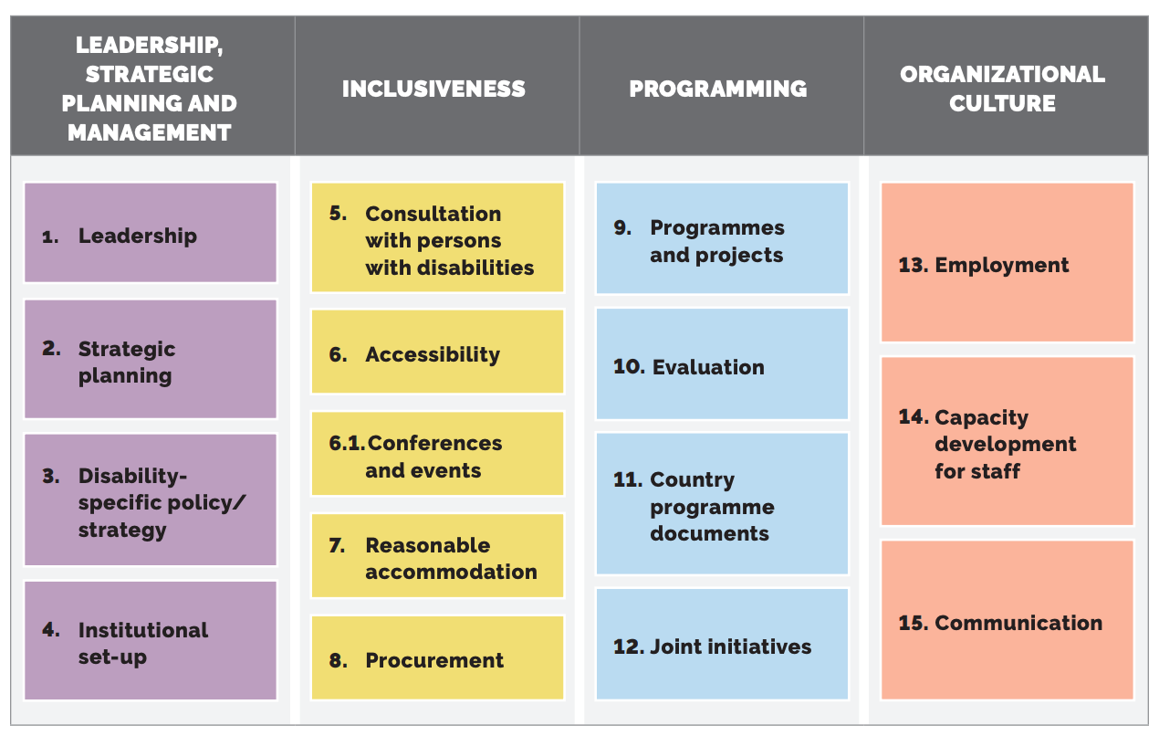
UN Disability Inclusion Strategy
UN Disability Inclusion Strategy

Slide 37
Armed Conflict and Humanitarian Crises
On 20 June 2019, the UN Security Council adopted a resolution on the situation of person with disabilities in armed conflict and humanitarian crises
It is a political commitment towards mainstreaming disability across all UN pillars, including peace and security.
The Resolution recognizes the Security Council’s serious concern regarding the disproportionate impact of armed conflict on persons with disabilities

Slide 38
Proposed Actions
Provide inclusive and accessible assistance
Take measures to ensure access to basic services provided in the context of armed conflict on an equal basis with others
Build capacity and knowledge of the rights and specific needs of persons with disabilities across UN peacekeeping and peacebuilding actors.
Critically, the resolution affirms the importance of meaningful participation and representation of, and consultation with, persons with disabilities and their representative organizations across all phases of conflict and crisis, and with all stakeholders.

Slide 39
Report on Rights of Persons with Disabilities in Armed Conflict
Report on rights of persons with disabilities in armed conflict examines the protection of the rights of persons with disabilities in the context of armed conflict.
The report takes stock of the dialogue started by Security Council resolution 2475 (2019) and is aimed at advancing the discussion on the topic in the light of the provisions of the Convention on the Rights of Persons with Disabilities and international humanitarian law.
https://undocs.org/en/A/76/146

Slide 40
Global Alliance for Disaster Resource Acceleration

Slide 41
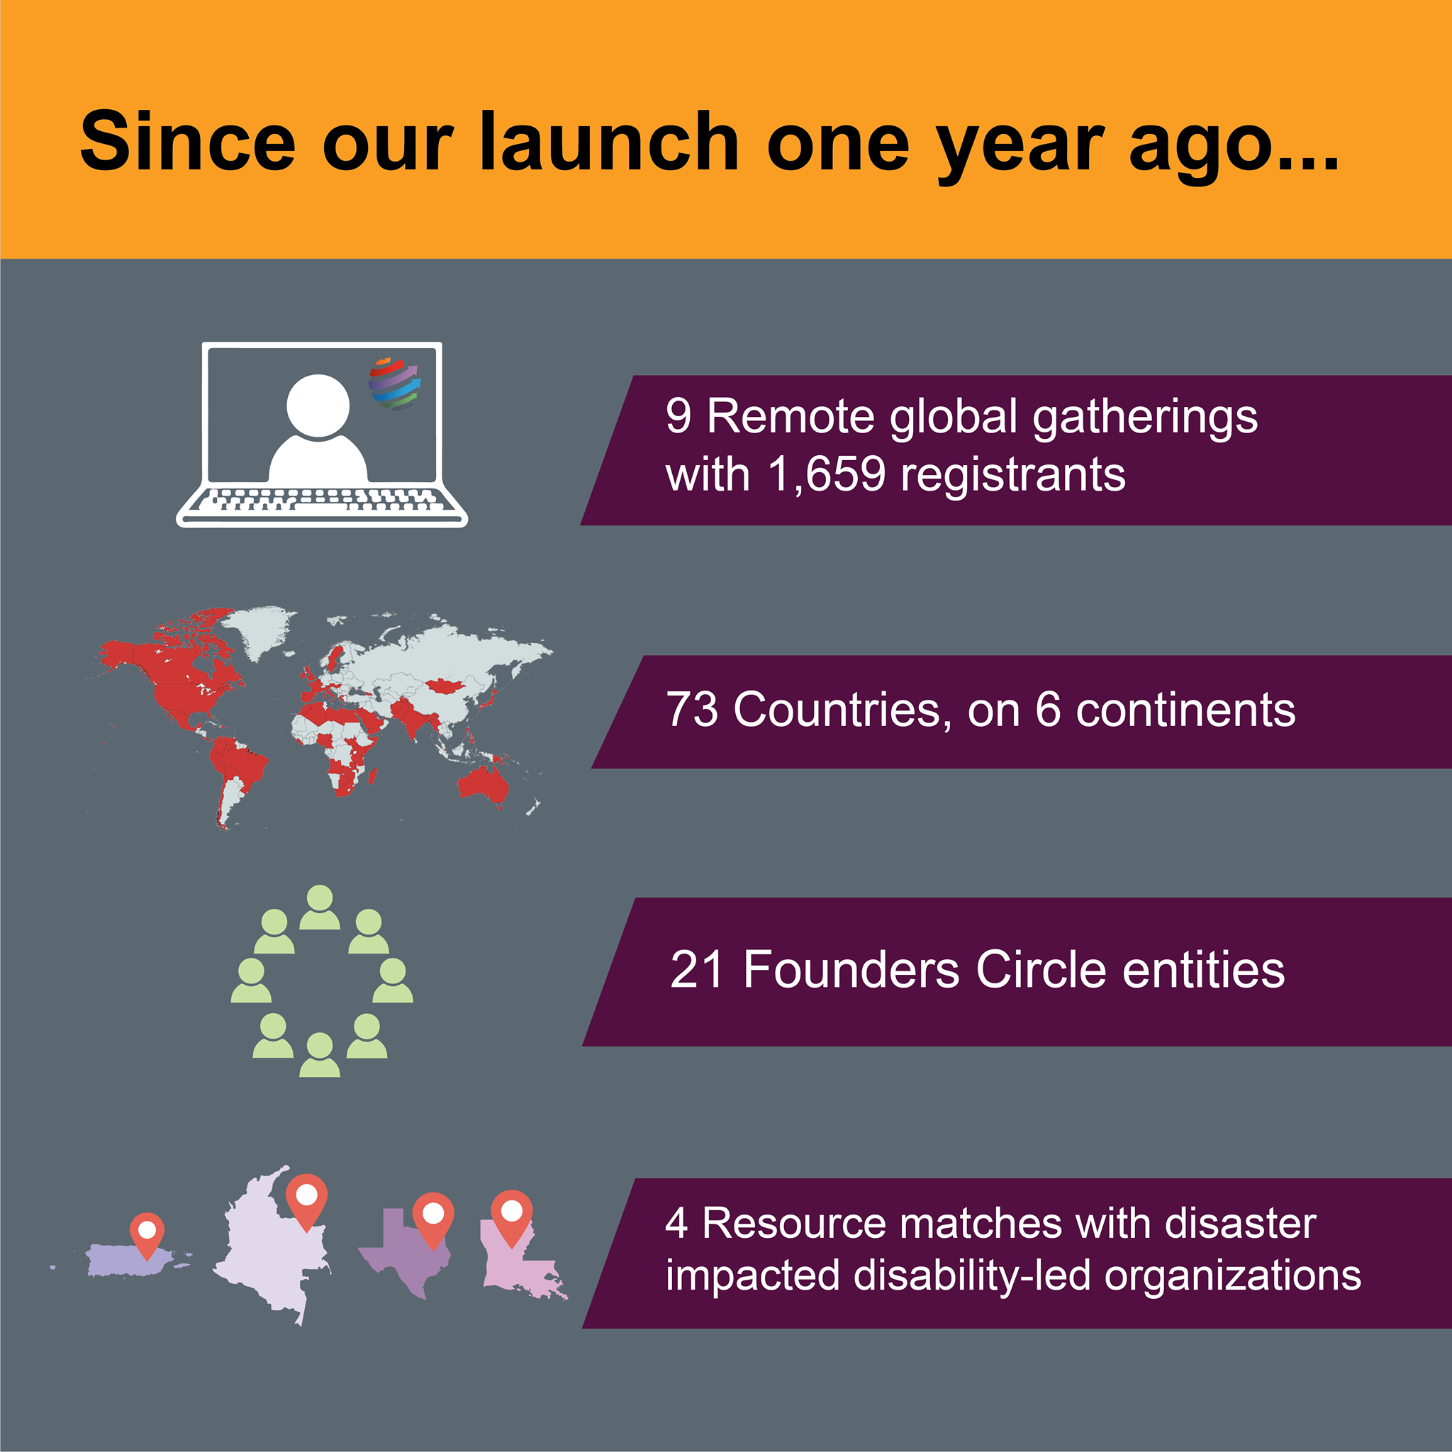
Global Alliance for Disaster Resource Acceleration

Slide 42
Join Our Next GADRA Event

Slide 43
Join GADRA
Click here to join GADRA

Slide 44
Intermediate Care Facilities for Individuals with Intellectual Disabilities
Marcie Roth
Executive Director and CEO
World Institute on Disability
+1(301) 717-7447
marcie@wid.org
www.wid.org

